Slide 1




Anxiety & Depression in the time of COVID-19
Data Analytics Bootcamp Project-1: Feb.10, 2021

Slide 2




The Team
Carolina Diaz
Anne LaFramboise
Isabel Dicely
Margaret Thorpe

Slide 3

We were wondering..….
Has the COVID pandemic had a negative impact on the mental health of our population?
Has it impacted the mental health of young adults (18-29)?
If so, in what ways?
Disrupted college plans?
Increased financial strain?
Caused health issues?

Slide 4
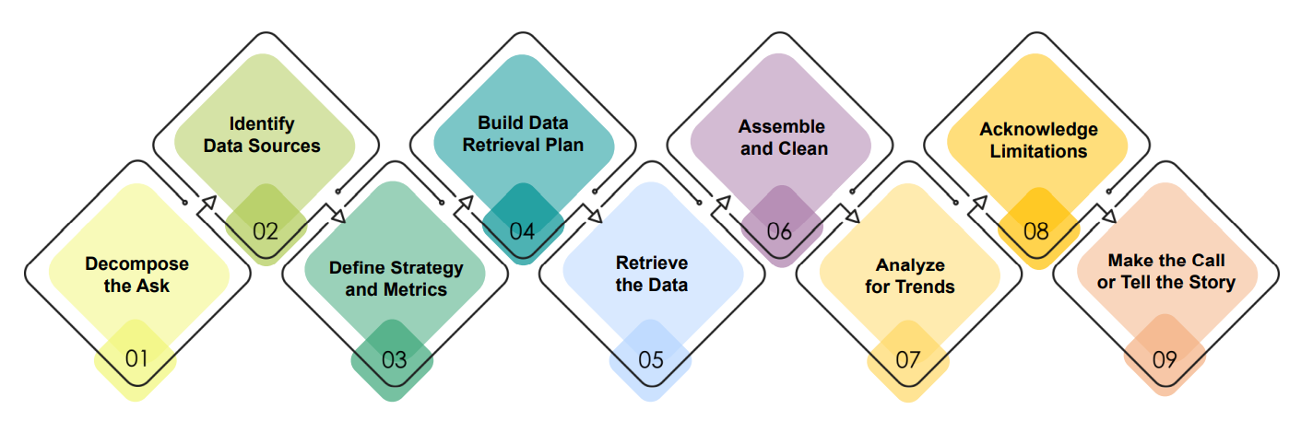
Our Process
Collect:
Daily COVID confirmed cases & deaths for US, CA & NY
IAD % s for US, CA & NY from weekly & bi-weekly surveys
Detailed Education, Employment & Housing tables from most recent Pulse survey
Issues:
Data complexity & quality
Missing data
Inconsistent measurement intervals
Structural limitations (columns vs. rows)
Outliers
Data Sources:
CDC: National Health Survey
CDC Household Pulse Survey
CDC COVID-19 Cases & Death data
Public Reporting: COVID timelines for CA & NY
Metrics:
- Baseline metrics from 2019
- Weekly metrics from 4/28/2020 – 1/28/2021:
% of people reporting IAD
# of confirmed cases of COVID-19
# of deaths from COVID-19
Data files were in .csv format
Used Excel and Pandas to retrieve and re-format it
Explored and analyzed data using:
bar charts
line graphs
Scatter plots
Linear regression
Notes:
- Identify Data Sources: The CDC has been publishing indicators of anxiety & depression (IAD) for decades. They started doing a new series of surveys after COVID-19 hit, with even more detailed questions.
- Define Strategy & Metrics: We focused primarily on weekly metrics from 4/28/2020 – 1/28/2021:
% of people reporting IAD
# of confirmed cases of COVID-19
# of deaths from COVID-19
We collected the data for the US, as well as for California and New York – so we could look for interesting regional patterns.
The Household Pulse Survey (HPS), an experimental data product, is an Interagency Federal Statistical Rapid Response Survey to Measure Household Experiences during the Coronavirus (COVID-19) Pandemic, conducted by the United States Census Bureau in partnership with seven other agencies from the Federal Statistical System: • Bureau of Labor Statistics (BLS) • National Center for Health Statistics (NCHS) • Department of Agriculture Economic Research Service (ERS) • National Center for Education Statistics (NCES) • Department of Housing and Urban Development (HUD) • Social Security Administration (SSA) • Bureau of Transportation Statistics (BTS)
- Anxiety & depression levels prior to the pandemic:
https://www.cdc.gov/nchs/data/nhis/earlyrelease/ERmentalhealth-508.pdf
- Anxiety & depression levels during the pandemic:
https://www.cdc.gov/nchs/covid19/pulse/mental-health.htm
- Johns Hopkins University COVID confirmed cases and death rates (2020-current):
https://healthdata.gov/dataset/united-states-covid-19-cases-and-deaths-state-over-time
- Key factors impacting young adults –Phase III of the CDC Household Pulse Survey
https://www.census.gov/programs-surveys/household-pulse-survey/data.html#phase3
- Key COVID-19 Shutdown and Re-opening dates for California & New York
Sources: State public health websites & public reporting

Slide 5
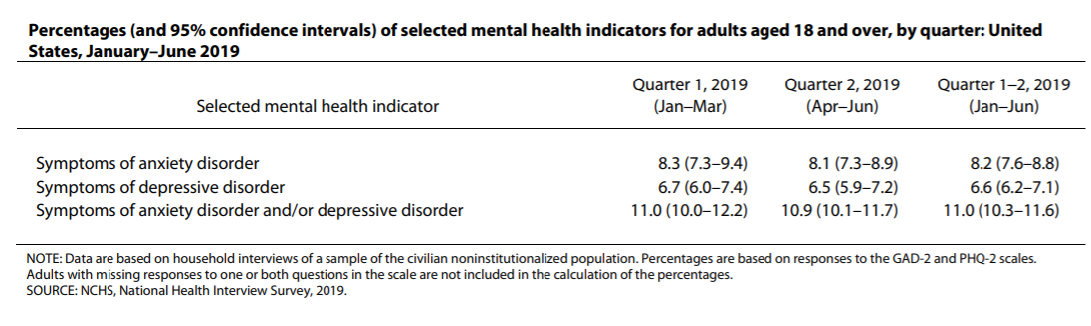
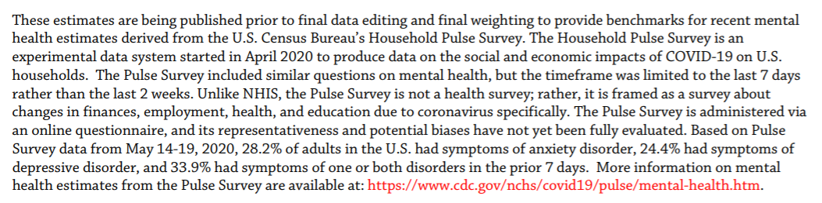
What did we discover?
The Baseline
In the first half of 2019 ~11% of American adults reported experiencing symptoms of anxiety and/or depressive disorders.
1
* Source: NCHS, National Health Interview Survey
In Comparison
In May, 2020 - 33.9% of American adults reported experiencing symptoms of anxiety and/or depressive disorders.
2
* Source: US Census Bureau, Household Pulse Survey, 2020-2021
Notes:
Survey Questions
Adapted PHQ-2 questions:
Over the last 7 days, how often have you been bothered by … having little interest or pleasure in doing things? Would you say not at all, several days, more than half the days, or nearly every day? Select only one answer.
Over the last 7 days, how often have you been bothered by … feeling down, depressed, or hopeless? Would you say not at all, several days, more than half the days, or nearly every day? Select only one answer.
Adapted GAD-2 questions:
Over the last 7 days, how often have you been bothered by the following problems … Feeling nervous, anxious, or on edge? Would you say not at all, several days, more than half the days, or nearly every day? Select only one answer.
Over the last 7 days, how often have you been bothered by the following problems … Not being able to stop or control worrying? Would you say not at all, several days, more than half the days, or nearly every day? Select only one answer.
Scoring and Estimation
For each scale, the answers are assigned a numerical value: not at all = 0, several days = 1, more than half the days = 2, and nearly every day = 3. The two responses for each scale are added together. A sum equal to three or greater on the PHQ-2 has been shown to be associated with diagnoses of major depressive disorder. A sum equal to three or greater on the GAD-2 has been shown to be associated with diagnoses of generalized anxiety disorder. For adults with scores of 3 or greater, further evaluation by a clinician or other health professional is generally recommended.
Estimates on this page are based on these composite scores. Answers to both questions in the scale were required to calculate the scores. Adults with missing responses to one or both questions are not shown separately in the tables and are not included in the calculation of percentages.

Slide 6




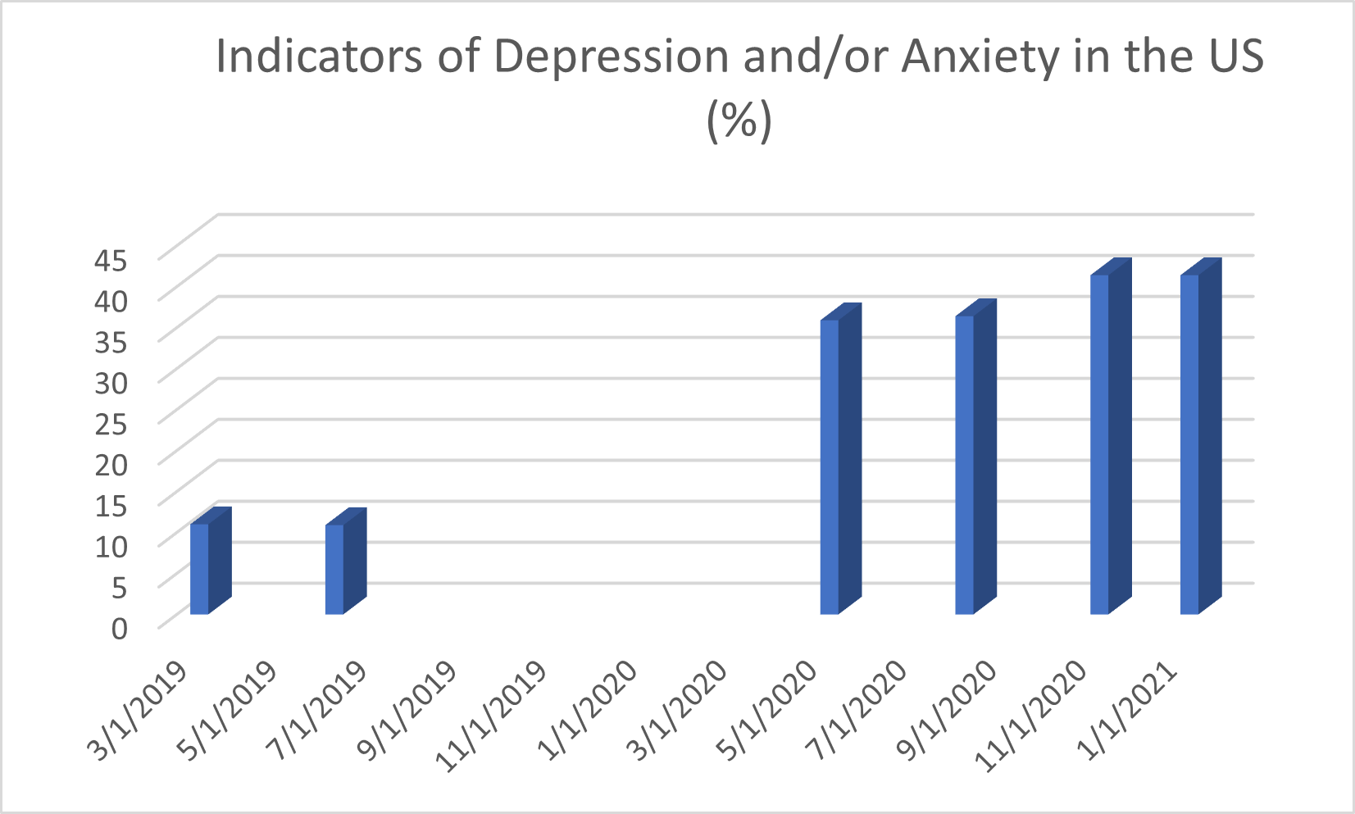
Anxiety & Depression Levels in the US
Anxiety and depression levels increased significantly amongst the US population between 2019-2021.
2019
2020
2021
In the first half of 2019, 11% of American adults reported experiencing symptoms of anxiety and/or depressive disorders.
In May, 2020, 33.9% of American adults reported experiencing symptoms of anxiety and/or depressive disorders.
In January 2021, 41.1% of American adults reported experiencing symptoms of anxiety and/or depressive disorders.
?

Slide 7

SO WHAT HAPPENED?

Slide 8
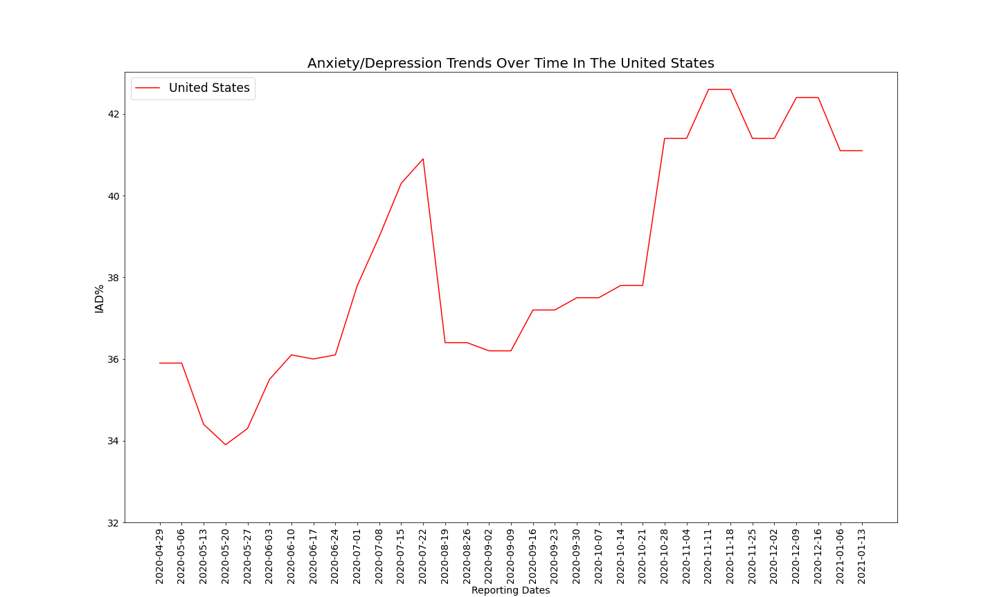
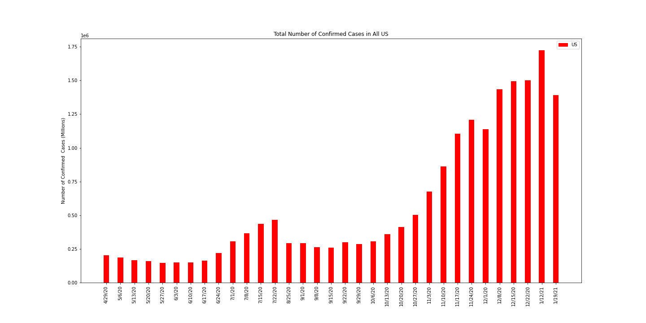
COVID-19 and Indicators of Anxiety and Depression (IAD) in the US
As the numbers of national COVID cases increased and decreased throughout the year, so did the anxiety and depression levels within the US population.

Slide 9
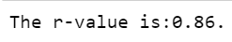
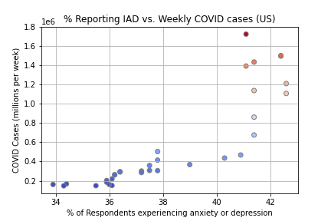
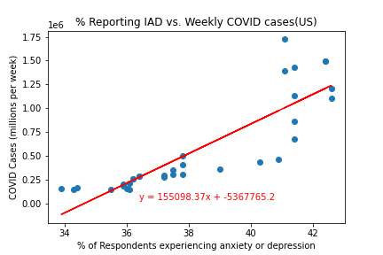
COVID-19 and Indicators of Anxiety and Depression (IAD) in the US
The higher the COVID case counts in the US, the higher the levels of anxiety and depression in the US population. There is a strong positive correlation between these
two variables.

Slide 10
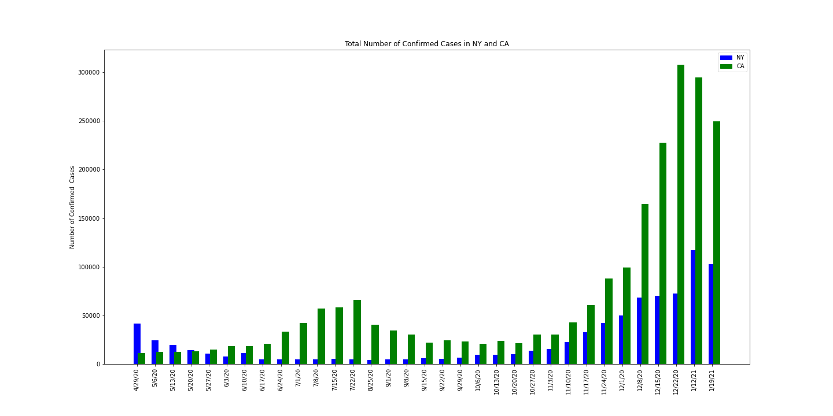
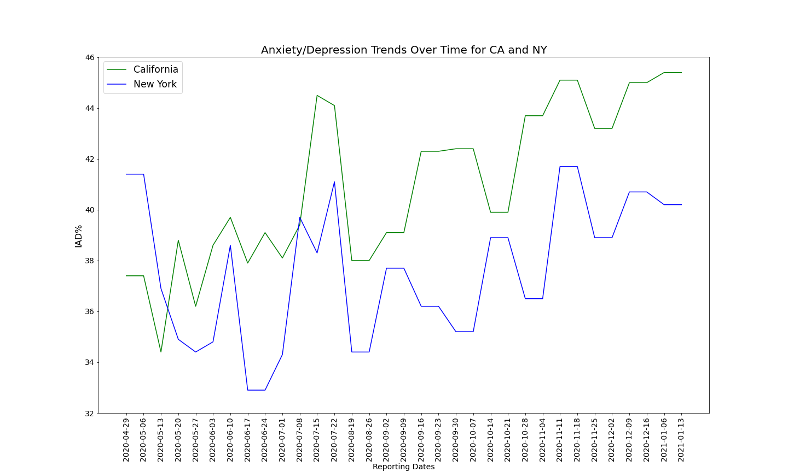
COVID-19 and Indicators of Anxiety and Depression (IAD) in New York and California
As the numbers of COVID cases increased and decreased throughout the year in California and New York, so did the anxiety and depression levels within the residents of those states.
Notes:
NY
3/7/2020 Governor declares state of emergency
3/15/2020 NYC Schools closed
3/20/2020 Statewide Stay-at-home order declared by Governor - non-essential businesses closed. Non-essential gatherings canceled/postponed.
3/27/2020 All schools statewide ordered to remain closed until April 15.
3/6/2020 Statewide stay-at-home order and school closures extended to April 29.
4/15/2020 All state residents ordered to wear face masks/coverings in public places where social distancing is not possible
4/16/2020 Statewide stay-at-home order and school closures extended to May 15.
5/1/2020 All schools and universities ordered to remain closed for the remainder of the academic year.
5/7/2020 Statewide four-phase reopening plan is first announced.
5/14/2020 Statewide state of emergency extended to June 13.
5/15/2020 Phase 1 of reopening allowed for counties that met qualifications. Five counties met qualifications and began reopening on this date.
5/23/2020 Gatherings of up to ten people allowed as long as social distancing is practiced.
6/8/2020 NYC Phase I reopening
6/22/2020 NYC Phase II reopening
7/6/2020 NYC Phase III reopening
7/15/2020 New restrictions on bars/restaurants only allowing alcohol to be served only to people ordering food.
8/7/2020 Schools allowed to open in-person in the fall if certain conditions are met.
12/1/2020 allowed schools in the orange or red zone to allow in-person instruction as long as they test 25% of their students weekly
12/8/2020 directed hospital bed capacity to be upgraded by 25 percent
1/27/2021 Cuomo lifted nearly all color zones across the state
CA
3/2/2020 State of Emergency declared by Governor
3/12/2020 Mass gatherings (over 250) people and social gatherings (over 10 people) banned
4/1/2020 Closure of all public and private schools (including institutions of higher education) ordered for the remainder of the 2018-2020 academic year
5/7/2020 State entered Stage 2 of its 4-stage reopening roadmap.
5/18/2020 Businesses that are part of Stage 3 allowed to reopen.
6/1/2020 Most indoor businesses, including restaurants, wineries, and movie theaters ordered to close in several counties.
6/18/2020 Universal masking guidance issued by Department of Public Health.
8/31/2020 BSE county-level restrictions take effect. More than 80% of population is under "Widespread" restrictions.
9/29/2020 Majority of population now under "Substantial" or lower BSE restrictions
11/10/2020 Majority of population back up to "Widespread" BSE restrictions
11/21/2020Nighttime curfew implemented for counties under "Widespread" BSE restrictions.
12/3/2020 Regional stay-at-home orders announced.
1/25/2021Nighttime curfew and regional stay-at-home orders lifted.

Slide 11
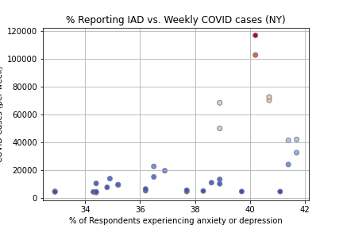
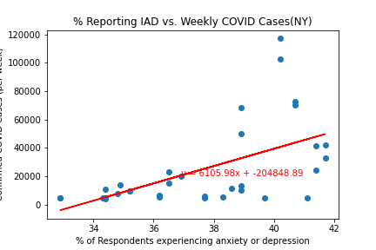
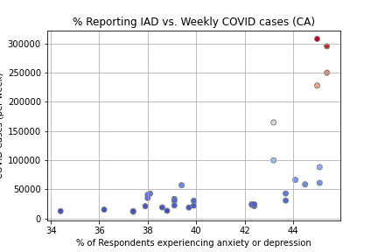
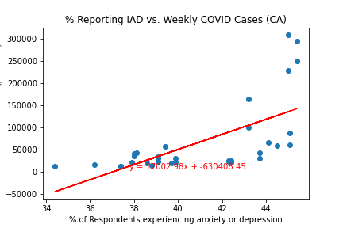
COVID-19 and IAD in NY and CA
The higher the COVID case counts in New York and California, the higher the levels of anxiety and depression in the residents of those states. There is a moderate positive correlation between these two variables.
The r-value for New York is 0.56
The r-value for California is 0.64

Slide 12

Digging Deeper

Slide 13
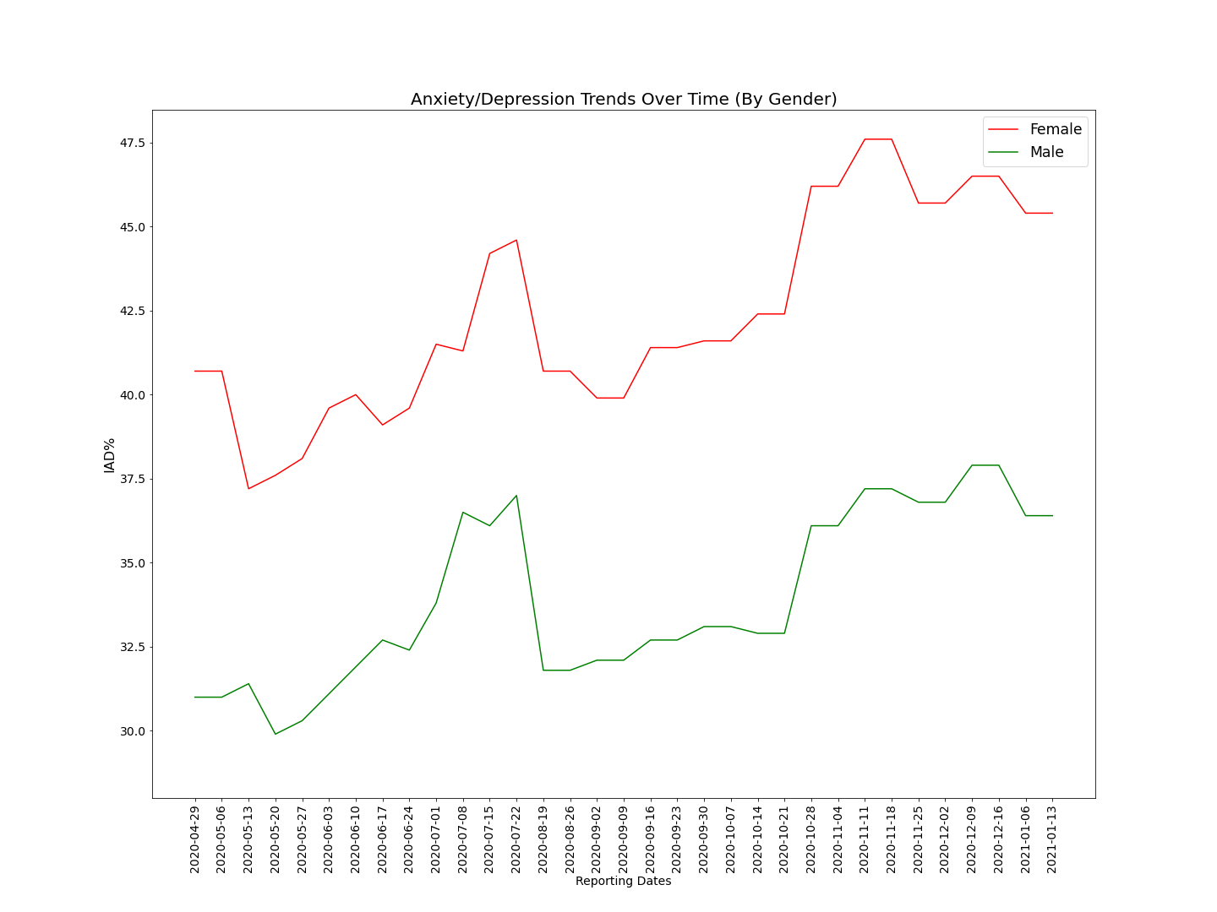
Anxiety & Depression in the US during the time of COVID-19 – a Gender perspective
Women reported experiencing significantly higher levels of anxiety and depression than men (roughly 25% higher) during this time.

Slide 14
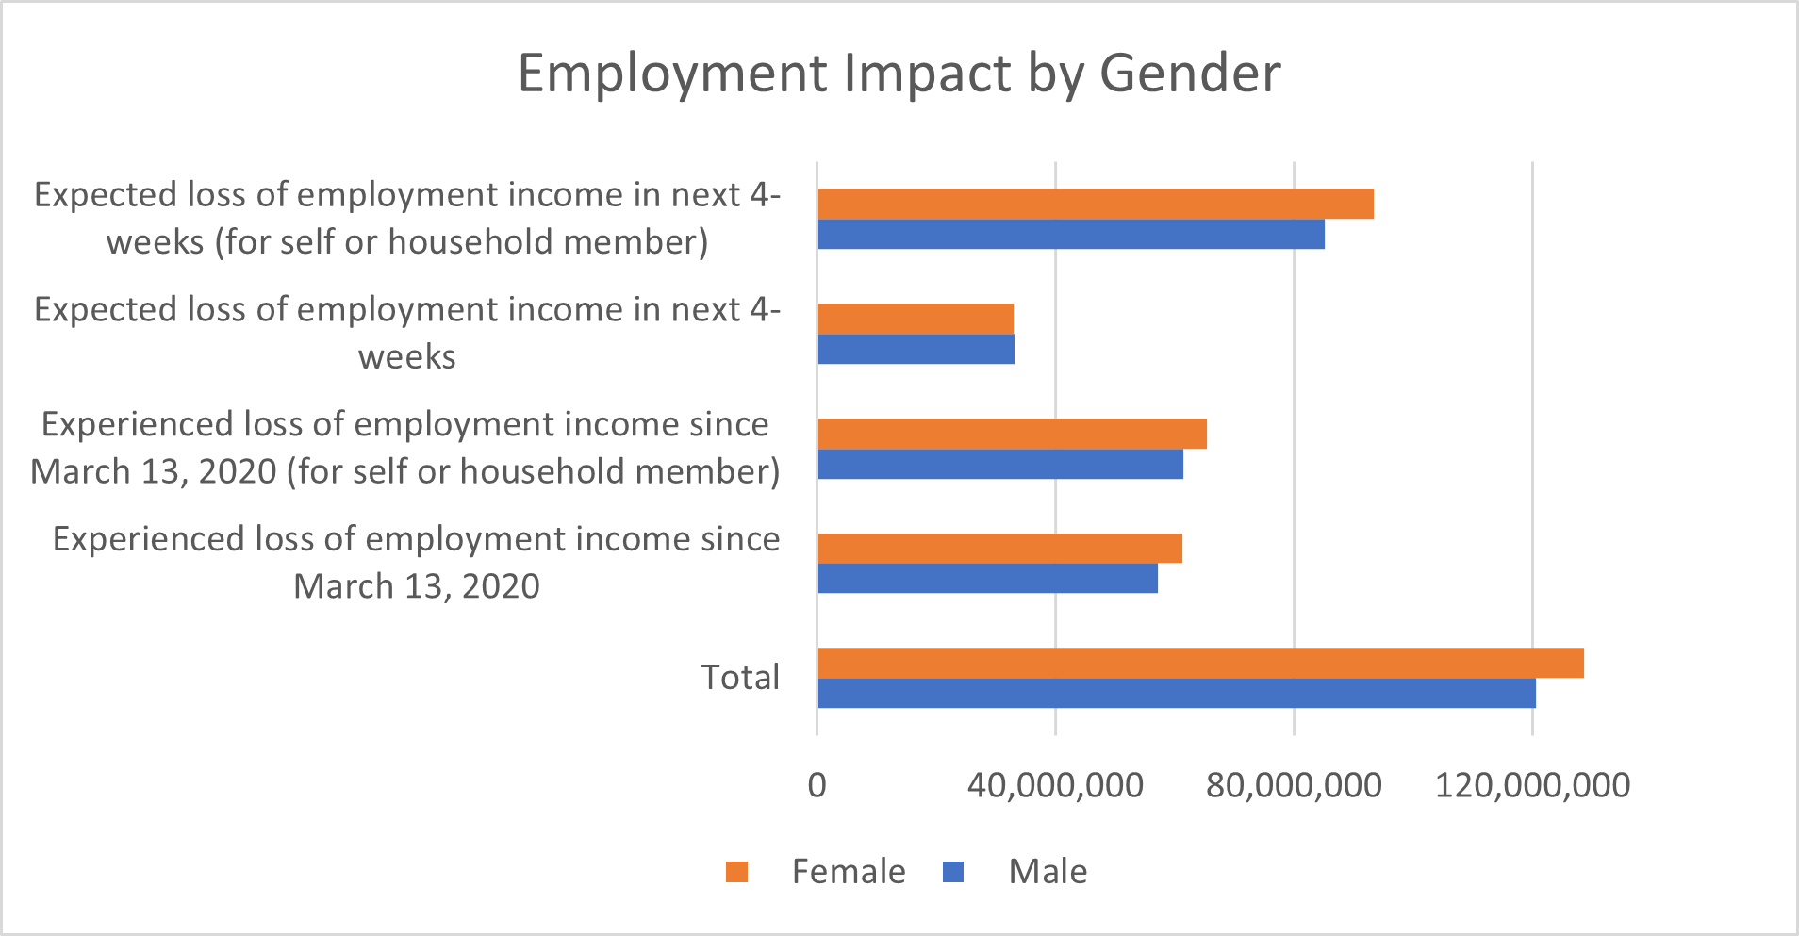
Anxiety & Depression in the US during the time of COVID-19 – a Gender perspective
Women experienced a higher loss of employment income. This could be contributing to higher levels of anxiety & depression.

Slide 15
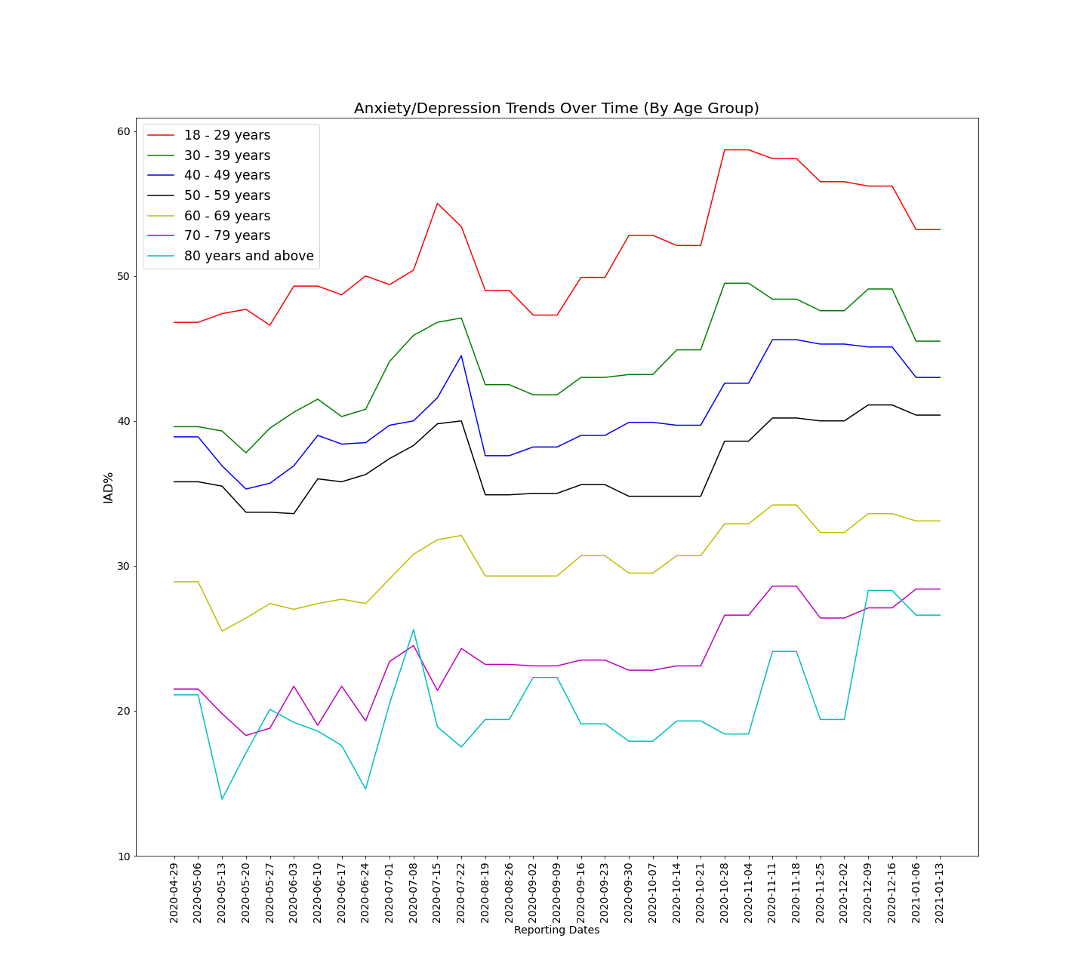
Anxiety & Depression in the US during the time of COVID-19 – by Age group
The younger the age group, the higher the levels of anxiety and depression. At the peak of the pandemic, over 50% of people 18-29 years old were experiencing symptoms of anxiety or depression.

Slide 16

Disrupted College Plans

Slide 17
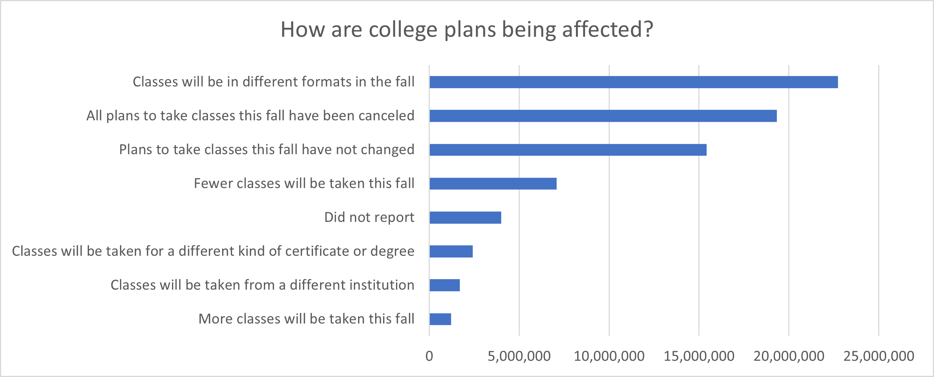
Disrupted College Plans – How?
Most college students experienced significant disruptions to their college plans as a result of either switching to an online format or having to completely cancel their college plans for the fall.
* Total Population 18 Years and Older (Households with Adults Planning On Taking College Classes This Fall)

Slide 18
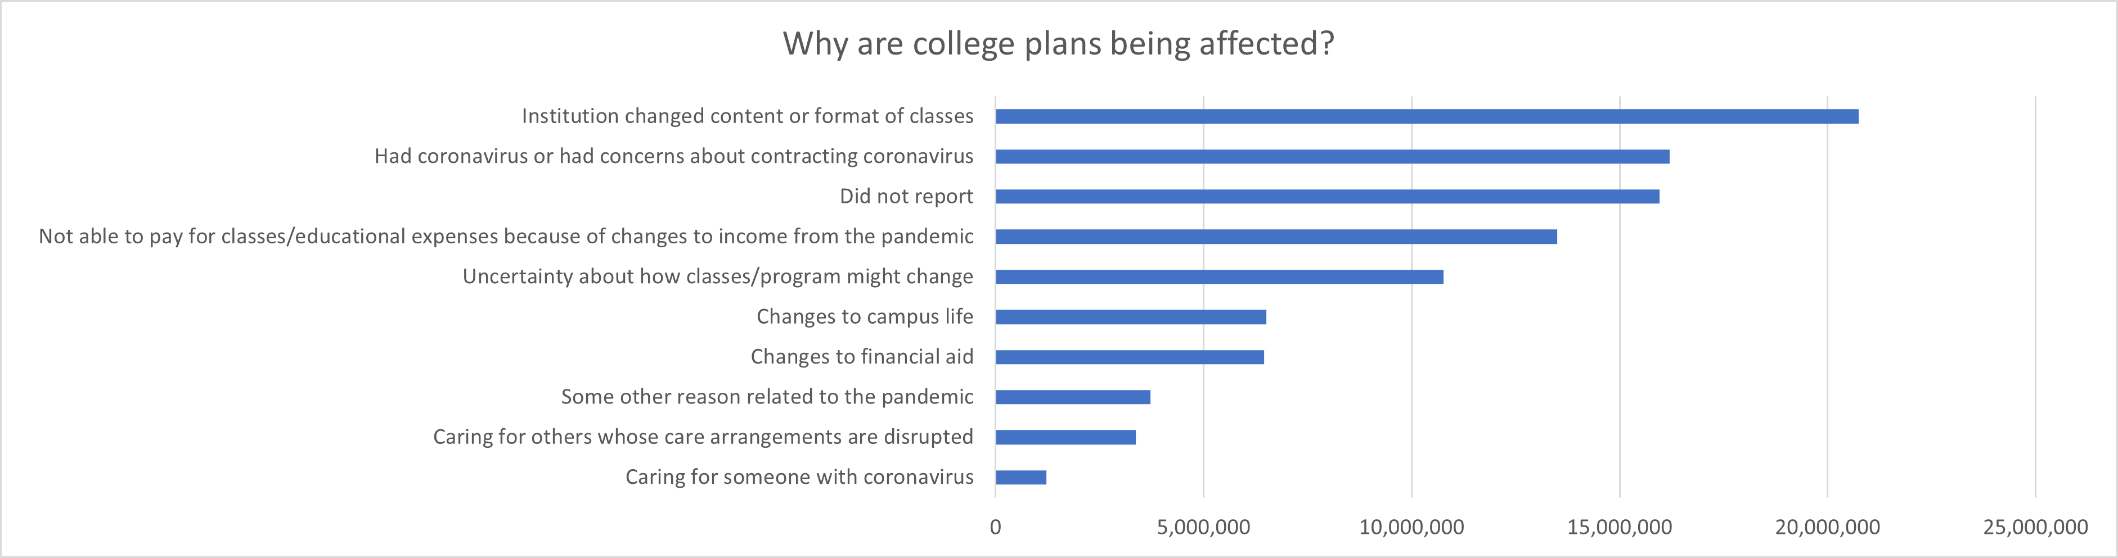
Disrupted College Plans – Why?
The main reasons most college student experienced disruption to their college plans were:
1 - their school switched formats,
2- they had COVID or were concerned about getting it, or
3- they were not able to pay for classes/expenses because of the financial impacts of the pandemic.
* Total Population 18 Years and Older (Households with Adults Planning On Taking College Classes This Fall)

Slide 19
Summary of Findings
Anxiety and depression levels increased significantly amongst the US population between 2019-2021.
As the numbers of national COVID cases increased and decreased throughout 2020, so did the anxiety and depression levels within the US population.
This was also true at the state level in California and New York (although it wasn’t as highly correlated as the national data).
Women reported experiencing significantly higher levels of anxiety and depression than men (roughly 25% higher) during this time.
It appears that women are experiencing a higher loss of employment income, which could be a contributing factor.
The younger the age group, the higher the levels of anxiety and depression. At the peak of the pandemic over 50% of people 18-29 years old were experiencing symptoms of anxiety or depression.
This may be, in part, a result of disrupted college plans as most college students experienced significant disruptions to their college plans.
Notes:
The mental health of Americans suffered significantly during the time of the COVID-19 pandemic
IAD% increased significantly from baseline level prior to pandemic & continued to increase throughout the pandemic
It appears that the COVID-19 pandemic may have contributed significantly to this deterioration
IAD% vs. Confirmed Cases(US) highly correlated
This really appears to be a national phenomena (regional patterns not as clear)
Young adults appear to have been even more negatively impacted
Evidence
The cause of this may be, in part, because of disruptions to their education
Evidence

Slide 20
The End

